Slide 1
SPATIAL THINKING and ITS DEVELOPMENT
Gale Olp Ekiss
Co-Coordinator
Compiled from materials from National Geographic Education Foundation (Audrey Mohan and Lindsey Mohan)

Slide 2
What is Spatial Thinking?
Spatial Thinking is one of the most important ways of thinking for a student to develop.
It is a unique way of thinking about the world.
Spatial thinking uses location, distance, direction, relationships, and movement to visualize, interpret, and reason about our world.
It is a “cultural universal” to want to organize space.
Notes:
Compiled from materials from National Geographic Education Foundation (Audrey Mohan and Lindsey Mohan)

Slide 3
What is Spatial Thinking?
When I say “3.5 billion people,” what do you picture?

Slide 4
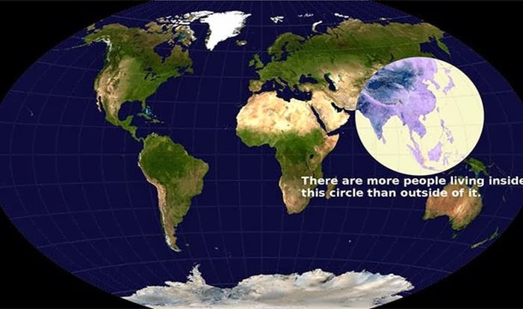
What is Spatial Thinking?
There are more people
living inside this circle
than outside of it.

Slide 5
Spatial Thinking
When I say “What feeds the Mississippi River,” what do you picture?

Slide 6
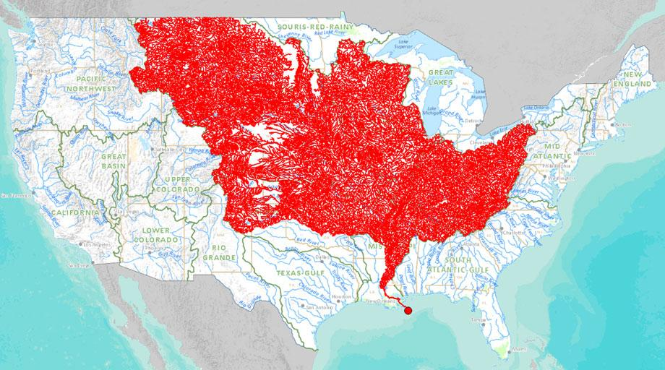
What is Spatial Thinking?
Rivers that feed into
the Mississippi
River

Slide 7
Why Teach Spatial Thinking?
Spatial thinking is an advantage in our increasingly global and technological society.
Spatial thinking is positively correlated with success in math and science.
Spatial thinking can be learned (enhanced) by quality instructional resources and activities.
Notes:
Compiled from materials from National Geographic Education Foundation (Audrey Mohan and Lindsey Mohan)

Slide 8
Identity and Location
Ages 3-6: Can locate and identify familiar things (home, school).
Ages 7-9: Can locate and identify with more accuracy familiar things and some unfamiliar things (countries, landmarks).
Ages 10-older: Should be able to read a map and locate and identify familiar and unfamiliar things.
Notes:
Compiled from materials from National Geographic Education Foundation (Audrey Mohan and Lindsey Mohan)

Slide 9
Magnitude
Ages 3-6: Can understand some scale words like big and small.
Ages 7-9: Just learning hierarchies (city, state, nation, world) and numbers (thousands, millions).
Ages 10-older: Should be able to correctly identify “scale” as local, national, global.
Notes:
Compiled from materials from National Geographic Education Foundation (Audrey Mohan and Lindsey Mohan)

Slide 10
Distance and Direction
Ages 3-6: Are learning relative location words (near, far, right, left).
Ages 7-9: Are learning to measure but make frequent errors. Understand directions on a map (N,E,S,W) but very little idea of how to realistically apply this knowledge. Have very little concept of distance.
Ages 10-older: Measuring more proficiently. Should be able to mentally locate places by direction and distance.
Notes:
Compiled from materials from National Geographic Education Foundation (Audrey Mohan and Lindsey Mohan)

Slide 11
Symbols
Ages 3-6: Know that the icon stands for something but may not be able to correctly identify what it represents.
Ages 7-9: Are transitioning from real-life icons to abstract symbols.
Ages 10-older: Use abstract symbols.
Notes:
Compiled from materials from National Geographic Education Foundation (Audrey Mohan and Lindsey Mohan)

Slide 12
Reference Frames
Ages 3-6: Learning numbers and alphabet.
Ages 7-9: Can use alpha-numeric grids (B-3,J-4) to find places. Learning to use latitude and longitude.
Ages 10-older: Proficient in using alpha-numeric grids. Forget how to use latitude and longitude and need reminders.
Notes:
Compiled from materials from National Geographic Education Foundation (Audrey Mohan and Lindsey Mohan)

Slide 13
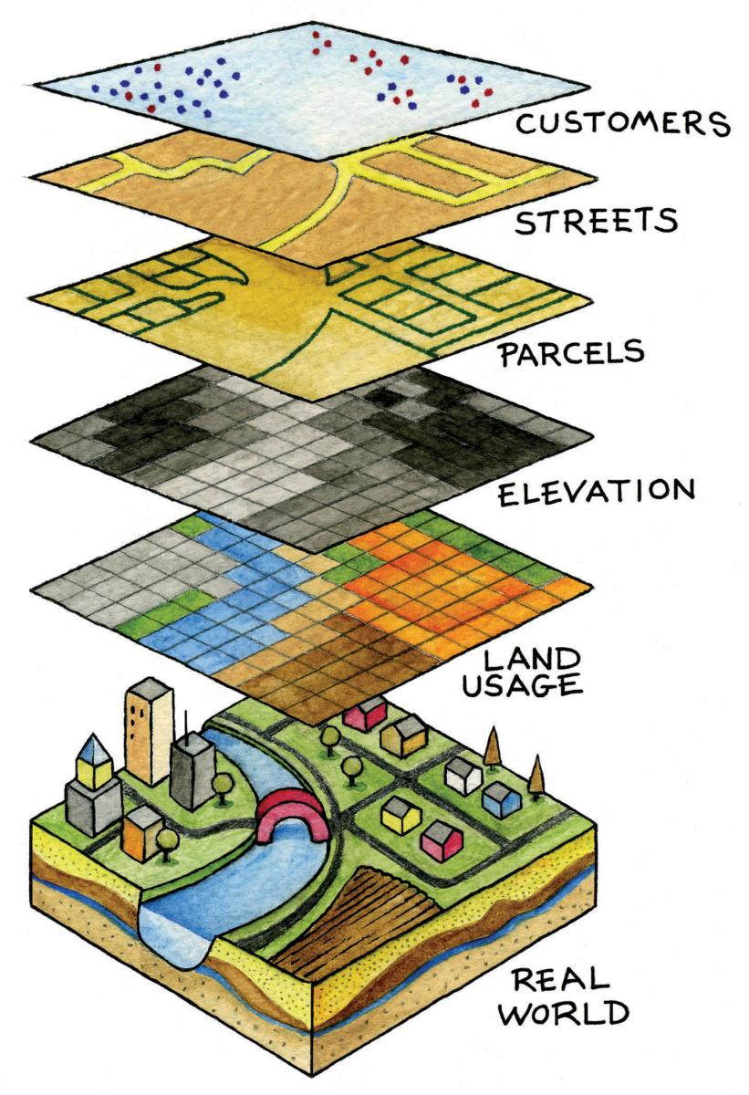
Overlays of Information
Ages 10-older: Can understand how data can be layered to show more information on a map. Should become interested in the technology that allows them to get the data and then to display it.
Notes:
Compiled from materials from National Geographic Education Foundation (Audrey Mohan and Lindsey Mohan)

